Slide 1


Find the name of each employee who lives in city “Miami”.

Slide 2

Find the name of each employee whose salary is greater than $100000.
Find the name of each employee who lives in “Miami” and whose salary is greater than $100000.

Slide 3

Consider the following expressions, which use the result of a relational algebra operation as the input to another operation. For each expression, explain in words what the expression does
Answer:
For each student who takes at least one course in 2009, display the students information along with the information about what courses the student took. The attributes in the result are:
ID, name, dept name, tot cred, course id, section id, semester, year, grade

Slide 4
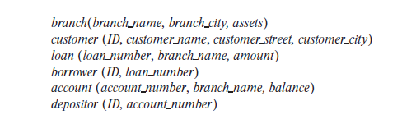

Slide 5
Find the name of each branch located in “Chicago”.
Find the ID of each borrower who has a loan in branch “Downtown”.

Slide 6
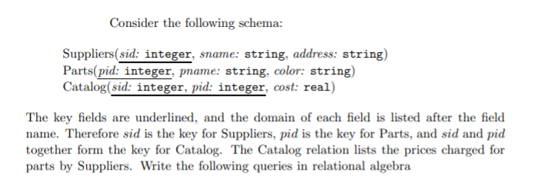

Slide 7
Find the names of suppliers who supply some red part.
Find the sids of suppliers who supply some red or green part.

Slide 8
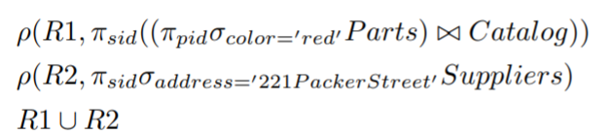
Find the sids of suppliers who supply some red part or are at 221 Packer Street.

Slide 9
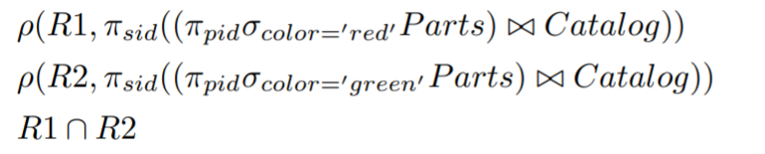

Find the sids of suppliers who supply some red part and some green part.
Find the sids of suppliers who supply every part.

Slide 10

Find the sids of suppliers who supply every red part.
Find the sids of suppliers who supply every red or green part.

Slide 11
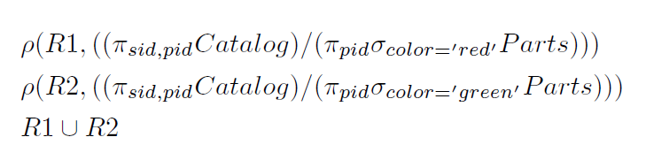
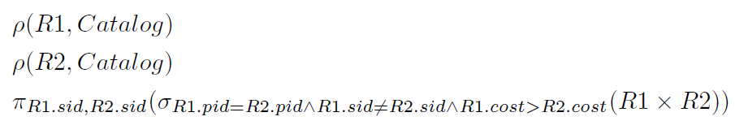
Find the sids of suppliers who supply every red or green part.
Find pairs of sids such that the supplier with the first sid charges more for some part than the supplier with the second sid.

Slide 12
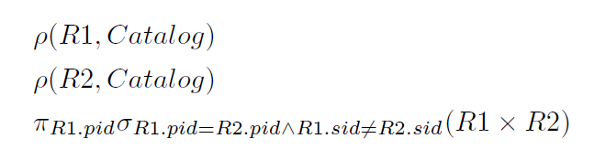
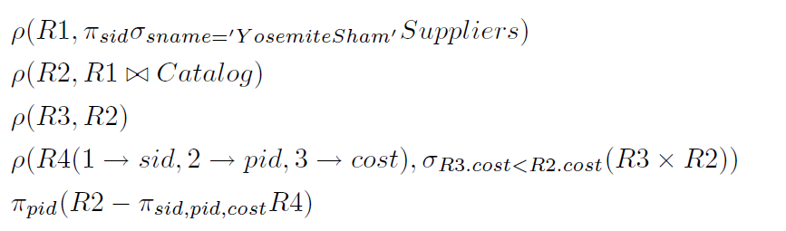
Find the pids of parts supplied by at least two different suppliers.
Find the pids of the most expensive parts supplied by suppliers named Yosemite Sham.

